Slide 1
Argon2 양자회로 구현 https://youtu.be/Kf5CRwGELQk
정보컴퓨터공학과 송경주

Slide 2
Argon2: a memory-hard function for password hashing and other applications
Argon2은 2015 Password Hashing Competition에서 우승한 key derivation function
자격 증명 저장, 키 파생 또는 기타 응용 프로그램을 위한 암호를 해시하는데 사용할 수 있음
가장 높은 메모리 채우기 속도와 여러 컴퓨팅 장치의 효과적인 사용을 목표로 하는 단순한 디자인을 가지고 있으면서도 트레이드오프에 대한 기능을 제공함
Argon2는 세가지 변형: Argon2i, Argon2d and Argon2id을 제공함
Argon2d: Argon2d는 더 빠르고 데이터에 의존하는 메모리 액세스를 사용하므로 GPU 크래킹 공격에 매우 강하고 사이드 채널 타이밍 공격(예: 암호화폐)의 위협이 없는 애플리케이션에 적합
Argon2i: 암호 해싱 및 암호 기반 키 파생에 선호되는 데이터 독립적 메모리 액세스를 사용하지만 트레이드 오프 공격으로부터 보호하기 위해 메모리를 더 많이 통과하므로 속도가 느림
Argon2id: Argon2i와 Argon2d의 하이브리드로, 데이터 종속 및 데이터 독립 메모리 액세스의 조합을 사용하여 사이드 채널 캐시 타이밍 공격에 대한 Argon2i의 일부 저항과 GPU 크래킹 공격에 대한 Argon2d의 대부분의 저항을 제공

Slide 3
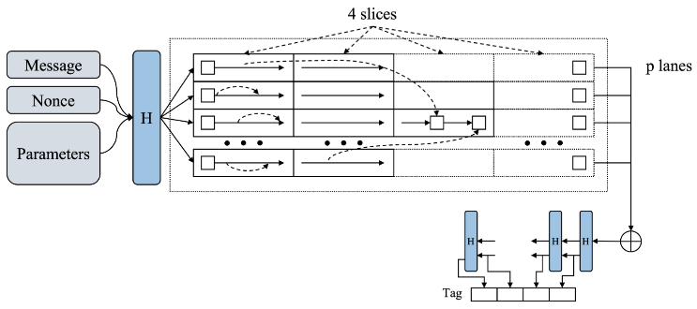
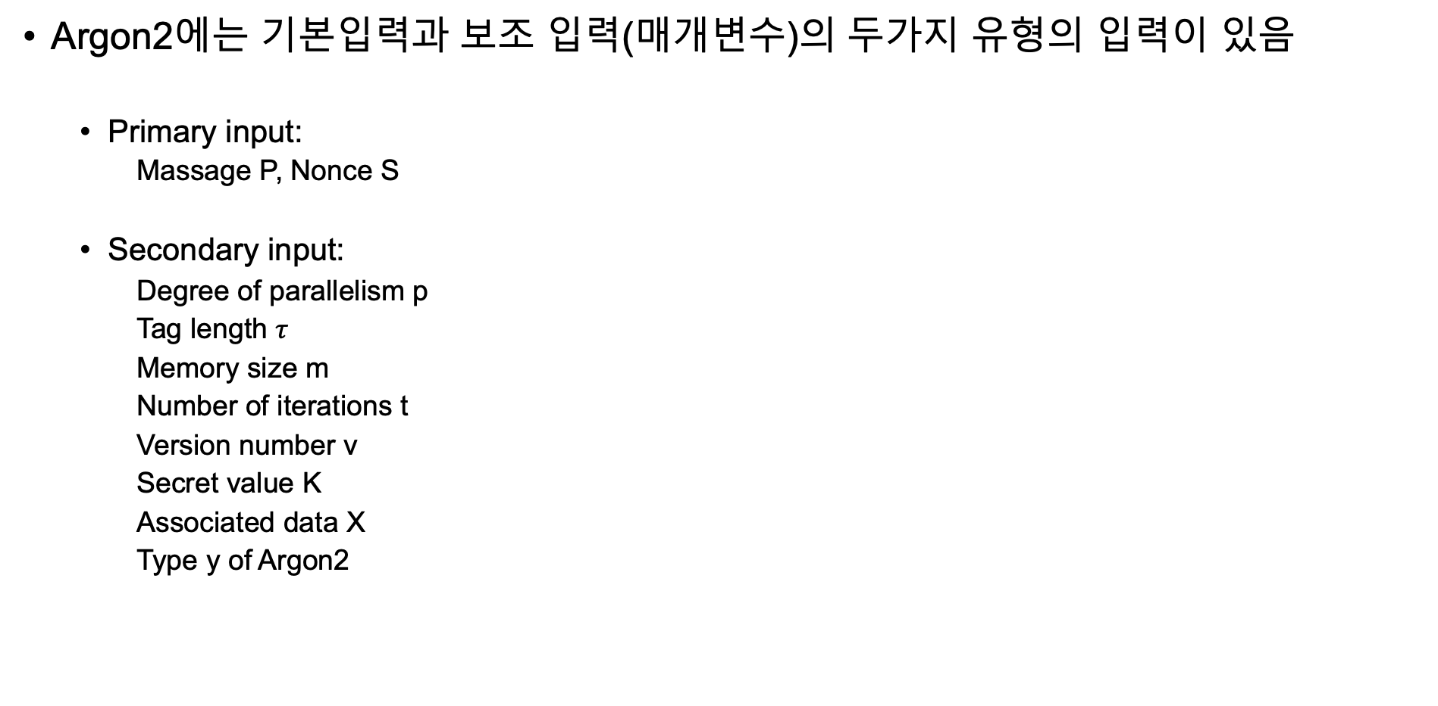
Argon2: a memory-hard function for password hashing and other applications
Argon2에는 기본입력과 보조 입력(매개변수)의 두가지 유형의 입력이 있음
Primary input:
Massage P, Nonce S
Secondary input:
Degree of parallelism p
Tag length $τ$
Memory size m
Number of iterations t
Version number v
Secret value K
Associated data X
Type y of Argon2

Slide 4
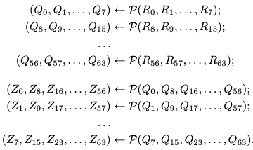

Argon2: a memory-hard function for password hashing and other applications
Compression function $G$
Argon2에서 사용하는 Compression function $G$ 는 Blake2b 라운드 함수 P를 기반으로 함
P는 8개의 16Byte 레지스터(128bit) 입력에서 동작한다.
Compression function $G\left(X,Y\right)$는 두개의 1024-byte block X, Y로 동작함
$R=\left(X⨁Y\right)$연산 후 R을 $R_{0}⋯R_{63}$ 으로 정의됨
row-wise 및 column-wise 순서로 P를 적용하여 Z를 얻음

Slide 5
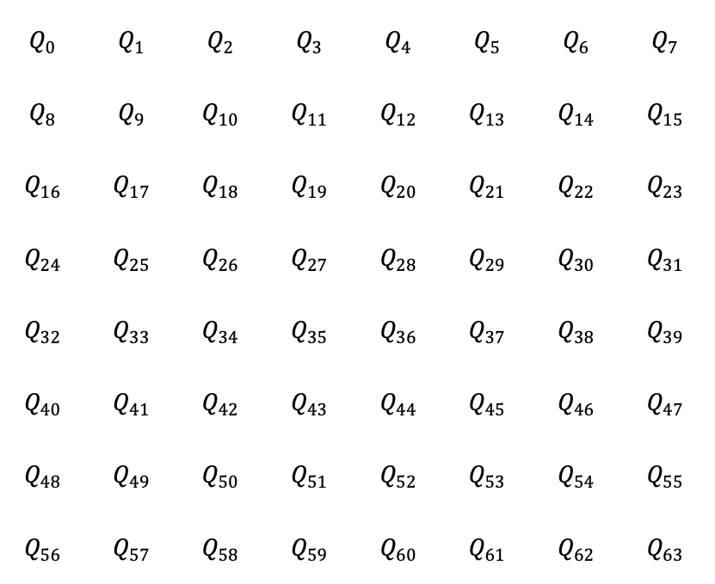
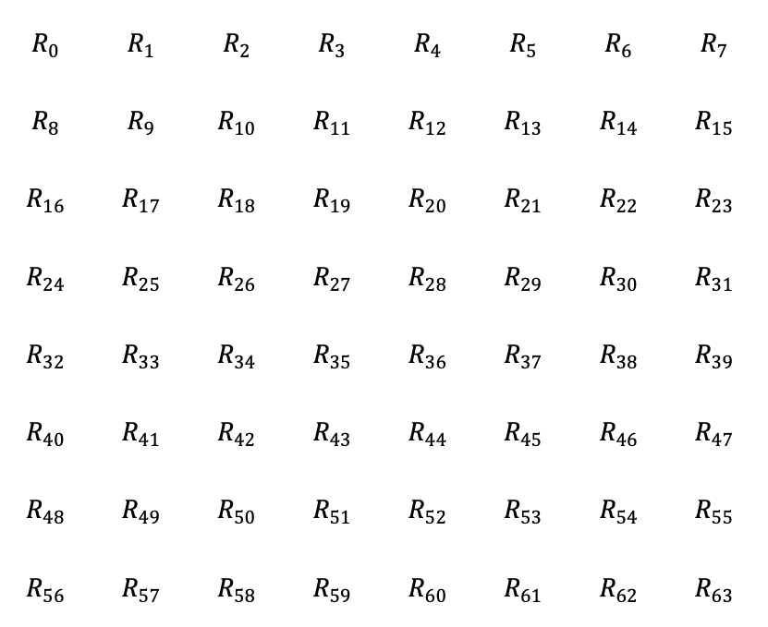

Argon2: a memory-hard function for password hashing and other applications
$$R_{0}$$ | $$R_{1}$$ | $$R_{2}$$ | $$R_{3}$$ | $$R_{4}$$ | $$R_{5}$$ | $$R_{6}$$ | $$R_{7}$$
$$R_{8}$$ | $$R_{9}$$ | $$R_{10}$$ | $$R_{11}$$ | $$R_{12}$$ | $$R_{13}$$ | $$R_{14}$$ | $$R_{15}$$
$$R_{16}$$ | $$R_{17}$$ | $$R_{18}$$ | $$R_{19}$$ | $$R_{20}$$ | $$R_{21}$$ | $$R_{22}$$ | $$R_{23}$$
$$R_{24}$$ | $$R_{25}$$ | $$R_{26}$$ | $$R_{27}$$ | $$R_{28}$$ | $$R_{29}$$ | $$R_{30}$$ | $$R_{31}$$
$$R_{32}$$ | $$R_{33}$$ | $$R_{34}$$ | $$R_{35}$$ | $$R_{36}$$ | $$R_{37}$$ | $$R_{38}$$ | $$R_{39}$$
$$R_{40}$$ | $$R_{41}$$ | $$R_{42}$$ | $$R_{43}$$ | $$R_{44}$$ | $$R_{45}$$ | $$R_{46}$$ | $$R_{47}$$
$$R_{48}$$ | $$R_{49}$$ | $$R_{50}$$ | $$R_{51}$$ | $$R_{52}$$ | $$R_{53}$$ | $$R_{54}$$ | $$R_{55}$$
$$R_{56}$$ | $$R_{57}$$ | $$R_{58}$$ | $$R_{59}$$ | $$R_{60}$$ | $$R_{61}$$ | $$R_{62}$$ | $$R_{63}$$
$$Q_{0}$$ | $$Q_{1}$$ | $$Q_{2}$$ | $$Q_{3}$$ | $$Q_{4}$$ | $$Q_{5}$$ | $$Q_{6}$$ | $$Q_{7}$$
$$Q_{8}$$ | $$Q_{9}$$ | $$Q_{10}$$ | $$Q_{11}$$ | $$Q_{12}$$ | $$Q_{13}$$ | $$Q_{14}$$ | $$Q_{15}$$
$$Q_{16}$$ | $$Q_{17}$$ | $$Q_{18}$$ | $$Q_{19}$$ | $$Q_{20}$$ | $$Q_{21}$$ | $$Q_{22}$$ | $$Q_{23}$$
$$Q_{24}$$ | $$Q_{25}$$ | $$Q_{26}$$ | $$Q_{27}$$ | $$Q_{28}$$ | $$Q_{29}$$ | $$Q_{30}$$ | $$Q_{31}$$
$$Q_{32}$$ | $$Q_{33}$$ | $$Q_{34}$$ | $$Q_{35}$$ | $$Q_{36}$$ | $$Q_{37}$$ | $$Q_{38}$$ | $$Q_{39}$$
$$Q_{40}$$ | $$Q_{41}$$ | $$Q_{42}$$ | $$Q_{43}$$ | $$Q_{44}$$ | $$Q_{45}$$ | $$Q_{46}$$ | $$Q_{47}$$
$$Q_{48}$$ | $$Q_{49}$$ | $$Q_{50}$$ | $$Q_{51}$$ | $$Q_{52}$$ | $$Q_{53}$$ | $$Q_{54}$$ | $$Q_{55}$$
$$Q_{56}$$ | $$Q_{57}$$ | $$Q_{58}$$ | $$Q_{59}$$ | $$Q_{60}$$ | $$Q_{61}$$ | $$Q_{62}$$ | $$Q_{63}$$
$$P$$

Slide 6
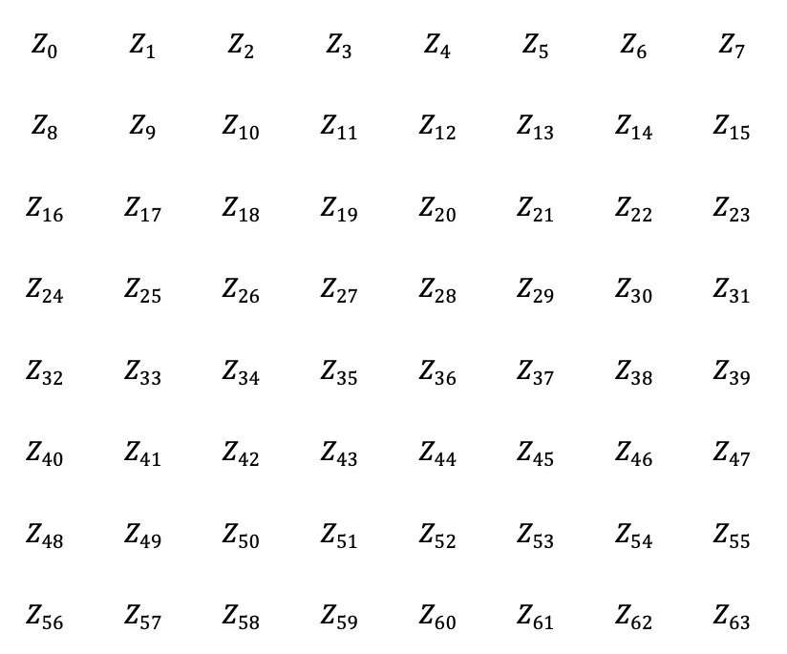
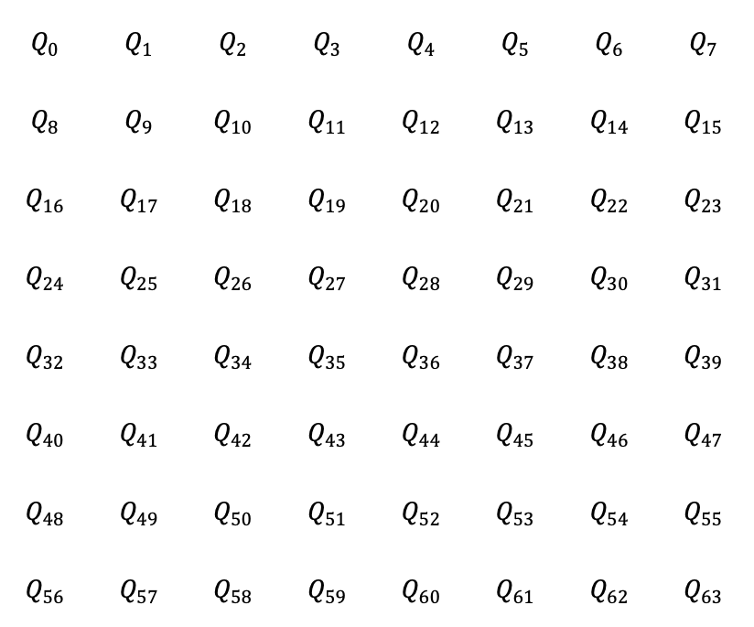
Argon2: a memory-hard function for password hashing and other applications
$$Q_{0}$$ | $$Q_{1}$$ | $$Q_{2}$$ | $$Q_{3}$$ | $$Q_{4}$$ | $$Q_{5}$$ | $$Q_{6}$$ | $$Q_{7}$$
$$Q_{8}$$ | $$Q_{9}$$ | $$Q_{10}$$ | $$Q_{11}$$ | $$Q_{12}$$ | $$Q_{13}$$ | $$Q_{14}$$ | $$Q_{15}$$
$$Q_{16}$$ | $$Q_{17}$$ | $$Q_{18}$$ | $$Q_{19}$$ | $$Q_{20}$$ | $$Q_{21}$$ | $$Q_{22}$$ | $$Q_{23}$$
$$Q_{24}$$ | $$Q_{25}$$ | $$Q_{26}$$ | $$Q_{27}$$ | $$Q_{28}$$ | $$Q_{29}$$ | $$Q_{30}$$ | $$Q_{31}$$
$$Q_{32}$$ | $$Q_{33}$$ | $$Q_{34}$$ | $$Q_{35}$$ | $$Q_{36}$$ | $$Q_{37}$$ | $$Q_{38}$$ | $$Q_{39}$$
$$Q_{40}$$ | $$Q_{41}$$ | $$Q_{42}$$ | $$Q_{43}$$ | $$Q_{44}$$ | $$Q_{45}$$ | $$Q_{46}$$ | $$Q_{47}$$
$$Q_{48}$$ | $$Q_{49}$$ | $$Q_{50}$$ | $$Q_{51}$$ | $$Q_{52}$$ | $$Q_{53}$$ | $$Q_{54}$$ | $$Q_{55}$$
$$Q_{56}$$ | $$Q_{57}$$ | $$Q_{58}$$ | $$Q_{59}$$ | $$Q_{60}$$ | $$Q_{61}$$ | $$Q_{62}$$ | $$Q_{63}$$
$$Z_{0}$$ | $$Z_{1}$$ | $$Z_{2}$$ | $$Z_{3}$$ | $$Z_{4}$$ | $$Z_{5}$$ | $$Z_{6}$$ | $$Z_{7}$$
$$Z_{8}$$ | $$Z_{9}$$ | $$Z_{10}$$ | $$Z_{11}$$ | $$Z_{12}$$ | $$Z_{13}$$ | $$Z_{14}$$ | $$Z_{15}$$
$$Z_{16}$$ | $$Z_{17}$$ | $$Z_{18}$$ | $$Z_{19}$$ | $$Z_{20}$$ | $$Z_{21}$$ | $$Z_{22}$$ | $$Z_{23}$$
$$Z_{24}$$ | $$Z_{25}$$ | $$Z_{26}$$ | $$Z_{27}$$ | $$Z_{28}$$ | $$Z_{29}$$ | $$Z_{30}$$ | $$Z_{31}$$
$$Z_{32}$$ | $$Z_{33}$$ | $$Z_{34}$$ | $$Z_{35}$$ | $$Z_{36}$$ | $$Z_{37}$$ | $$Z_{38}$$ | $$Z_{39}$$
$$Z_{40}$$ | $$Z_{41}$$ | $$Z_{42}$$ | $$Z_{43}$$ | $$Z_{44}$$ | $$Z_{45}$$ | $$Z_{46}$$ | $$Z_{47}$$
$$Z_{48}$$ | $$Z_{49}$$ | $$Z_{50}$$ | $$Z_{51}$$ | $$Z_{52}$$ | $$Z_{53}$$ | $$Z_{54}$$ | $$Z_{55}$$
$$Z_{56}$$ | $$Z_{57}$$ | $$Z_{58}$$ | $$Z_{59}$$ | $$Z_{60}$$ | $$Z_{61}$$ | $$Z_{62}$$ | $$Z_{63}$$
$$P$$

Slide 7
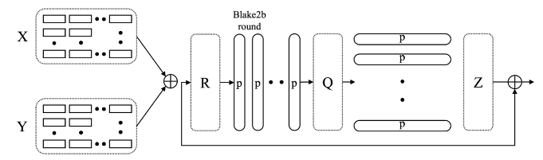

Argon2: a memory-hard function for password hashing and other applications
Compression function $G$

Slide 8
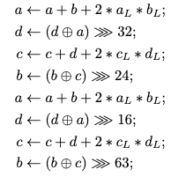
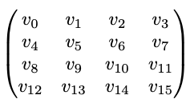
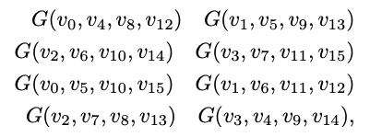

Argon2: a memory-hard function for password hashing and other applications
Permutation $P$
8개의 16-byte input $S_{0}, S_{1}{⋯S}_{7}$가 64bit 워드의 $4×4 matrix$로 표현된다.
$S_{i}=(v_{2i+1}||v_{2i})$

Slide 9


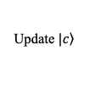





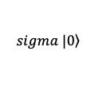

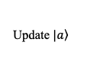

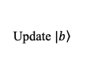

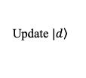
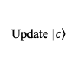
















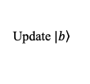




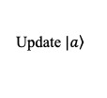





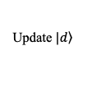


Argon2 양자회로 구현
$∗$ Inverse Point 1
$∗$ Start Point 1
$∗$ Inverse Point 2
$∗$ Start Point 2
$$m$$
=1
=1
=1
=1
$$⨁$$
$$Add$$
$$\left.|sigma\right\rangle$$
$$⨁$$
$$\left.|0\right\rangle$$
$$⨁$$
$$Add$$
$$\left.|sigma\right\rangle$$
$$⨁$$
$$\left.|0\right\rangle$$
$$\left.sigma |0\right\rangle$$
$$\left.|a\right\rangle$$
$$Add$$
$$\left.|a\right\rangle +\left.|b\right\rangle$$
$$\left.|a\right\rangle +\left.|b\right\rangle +\left.|sigma\right\rangle$$
$$Add$$
$$\left.|a\right\rangle +\left.|b\right\rangle$$
$$\left.|a\right\rangle +\left.|b\right\rangle +\left.|sigma\right\rangle$$
$$\left.|b\right\rangle$$
$$\left.|b\right\rangle$$
$$⨁$$
$$⋙24$$
$$\left.|b\right\rangle$$
$$⨁$$
$$⋙63$$
$$\left.|c\right\rangle$$
$$Add$$
$$\left.|c\right\rangle +\left.|d\right\rangle$$
$$Add$$
$$\left.|c\right\rangle +\left.|d\right\rangle$$
$$\left.|d\right\rangle$$
$$⨁$$
$$⋙32$$
$$\left.|d\right\rangle$$
$$⨁$$
$$⋙16$$
$$\left.|d\right\rangle$$
Update $\left.|a\right\rangle$
Update $\left.|d\right\rangle$
Update $\left.|c\right\rangle$
Update $\left.|b\right\rangle$
Update $\left.|a\right\rangle$
Update $\left.|d\right\rangle$
Update $\left.|c\right\rangle$
Update $\left.|b\right\rangle$
(1) Qubit-optimized Quantum circuit for G

Slide 10

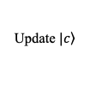
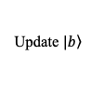



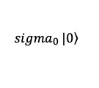
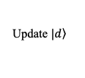

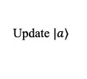

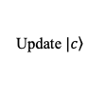















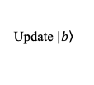




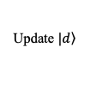


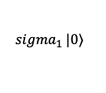


Argon2 양자회로 구현
$$m$$
=1
=1
$${sigma}_{0}\left. |0\right\rangle$$
$$⨁$$
$$Add$$
$$\left.|sigma\right\rangle$$
$${sigma}_{1}\left. |0\right\rangle$$
$$⨁$$
$$Add$$
$$\left.|sigma\right\rangle$$
$$\left.|a\right\rangle$$
$$Add$$
$$\left.|a\right\rangle +\left.|b\right\rangle$$
$$Add$$
$$\left.|a\right\rangle +\left.|b\right\rangle +\left.|sigma\right\rangle$$
$$Add$$
$$\left.|a\right\rangle +\left.|b\right\rangle$$
$$\left.|a\right\rangle +\left.|b\right\rangle +\left.|sigma\right\rangle$$
$$\left.|b\right\rangle$$
$$\left.|b\right\rangle$$
$$⨁$$
$$⋙24$$
$$\left.|b\right\rangle$$
$$⨁$$
$$⋙63$$
$$\left.|c\right\rangle$$
$$Add$$
$$\left.|c\right\rangle +\left.|d\right\rangle$$
$$Add$$
$$\left.|c\right\rangle +\left.|d\right\rangle$$
$$\left.|d\right\rangle$$
$$⨁$$
$$⋙32$$
$$\left.|d\right\rangle$$
$$⨁$$
$$⋙16$$
$$\left.|d\right\rangle$$
Update $\left.|a\right\rangle$
Update $\left.|d\right\rangle$
Update $\left.|c\right\rangle$
Update $\left.|b\right\rangle$
Update $\left.|a\right\rangle$
Update $\left.|d\right\rangle$
Update $\left.|c\right\rangle$
Update $\left.|b\right\rangle$
(2) Depth-optimized Quantum circuit for G

Slide 11
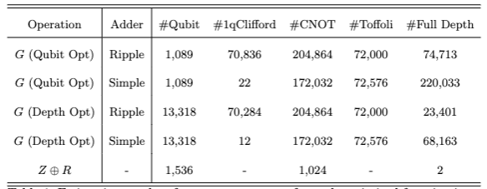
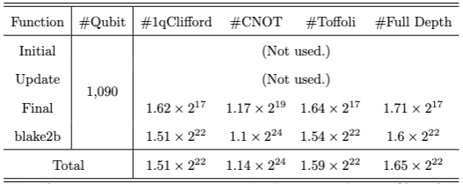
Argon2 양자회로 구현

